Slide 1
Search Engine on Movies
Ekal golas
Kevin george
Asha mary Thomas
Saumya ann George
Navaneeth venugopala rao

Slide 2
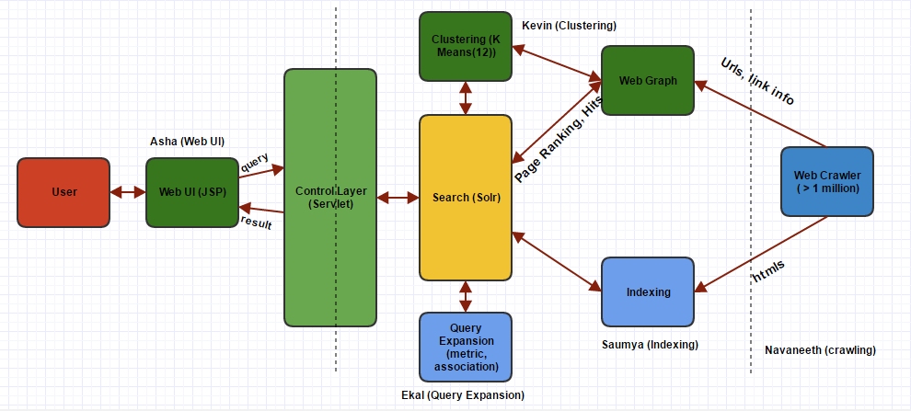
Search Engine Architecture for Movies

